Slide 1
image Processing Toolbox (chapter 10)
Dr. Uyen Nguyen

Slide 2
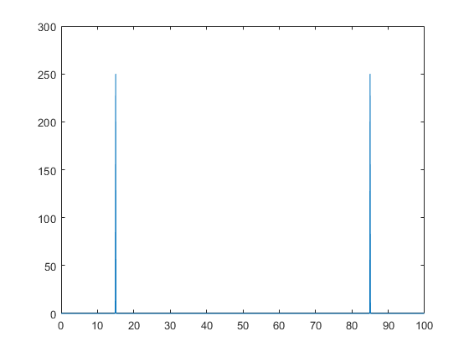
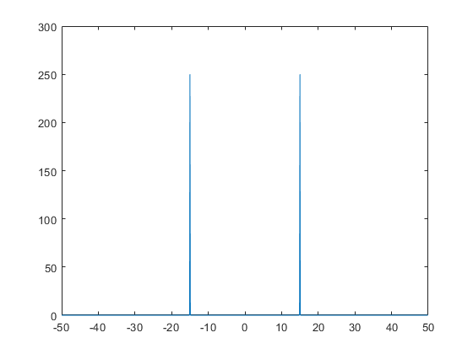
Understand fftshift
fs = 100; % sampling frequency
t = 0:(1/fs):(10-1/fs); % time vector
S = cos(2*pi*15*t);
n = length(S);
X = fft(S);
f = (0:n-1)*(fs/n); %frequency range
power = abs(X).^2/n; %power
plot(f,power)
Y = fftshift(X);
fshift = (-n/2:n/2-1)*(fs/n); % zero-centered frequency range
powershift = abs(Y).^2/n; % zero-centered power
plot(fshift,powershift)

Slide 3
Understand fftshift
%Create a white box
testi(500,500)=0;
testi(225:275,225:275)=1;
%show the original image:
figure(1)
imshow(testi)
%take the fft2
testifft=fft2(testi);
figure(2)
imshow(testifft)
%shift the fft2
testishift=fftshift(testifft);
figure(3)
imshow(testishift)
%take the real part by taking the absolute
testiabs=abs(testishift);
figure(4)
imshow(testiabs)
%from the fft we can get the original image back
testire=abs(ifft2(testishift));
figure(5)
imshow(mat2gray(testire))

Slide 4
Detecting Edges
%Load the moon image
testi=imread('moon.tif');
%show the original image:
figure(1)
imshow(testi)

Slide 5
Detecting Edges
%perform fft2 on the moon image
%Shift the frequency to the middle of the FFT image

Slide 6
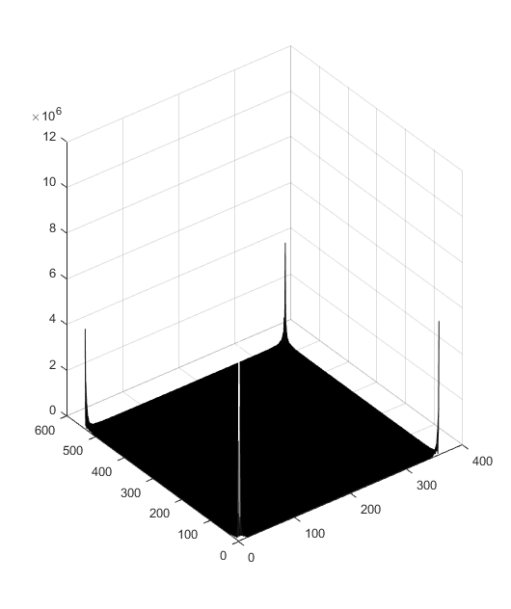
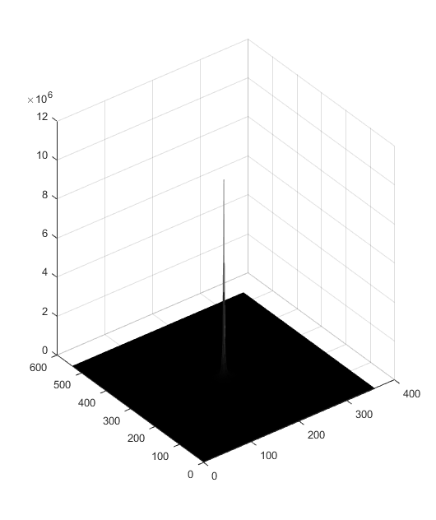
Detecting Edges
You use the command Mess to see 3D
Mesh(abs(testifft))
Mesh(abs(testishift)

Slide 7
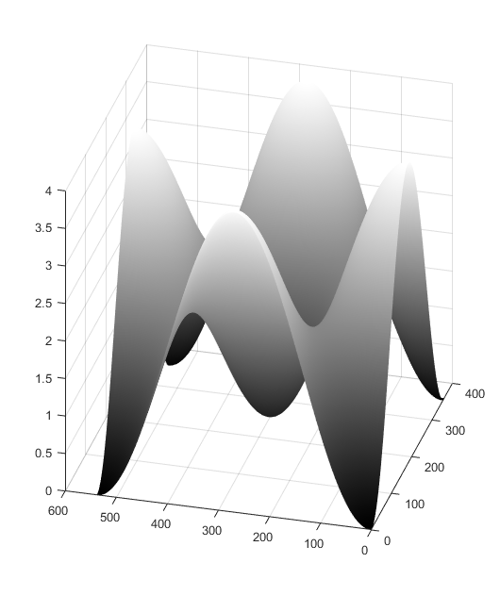
Detecting Edges
%creat a lapacian filter
%make sure the size is the same as the original image
[M ,N]=size(testi);
h=fspecial('laplacian',.9)
H=fft2(h,M, N);
figure(5)
imshow(H)
Use Mesh command to see the Laplacian filter in 3D

Slide 8
Detecting Edges
%apply the filter H to the fft2 of the moon image by multiply the H(f)*I(f)
%Then use the ifft command to perform the inverse of Fourier transform to get the image back.
%Plot the Inverse Fourier image in gray scale

Slide 9
Motion Images
F1 is coming to Vietnam, If you take a picture it might be blurred due to the motion of the vehicle is too fast

Slide 10
Motion Images
Given an original image, we will add a motion filter to create a blurred image

Slide 11
Motion Images
%read image
I = imread('f1jpeg.jpeg');
figure; imshow(I); title('Original Image');

Slide 12
Motion Images
%Create the filter for motion
LEN = 31;
THETA = 11;
PSF = fspecial('motion',LEN,THETA);
Use Mesh to see the filter in 3D

Slide 13
Motion Images
%add the bluring motion into the image
Blurred = imfilter(I,PSF,'circular','conv');
Figure(3);
imshow(Blurred);
title('Blurred Image')

Slide 14
Restore the blurred image
%restore image without paying attention to noise
wnr2 = deconvwnr(blurred, PSF, 0);
figure(4)
imshow(wnr2)
title('Restoration of Blurred, Noisy Image Using NSR = 0')

Slide 15
Smear Image
Given a clear image, with a grease smear

Slide 16
Smear Image
%read image
I = imread('cameraman.tif');
figure, imshow(I)
title('Original Image')
PSF = fspecial(‘gaussian',7,10);
You are creating a gaussian filter and plot the smeared image using the command imfilter

Slide 17
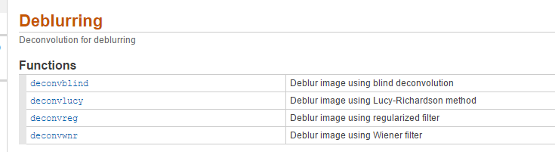

Slide 18
Deconvblind
INITPSF = ones(size(PSF));
[J P]= deconvblind(Blurred,INITPSF,30);
figure, imshow(J)
title('Restored Image')

Slide 19
Deconvwnr
INITPSF = ones(size(PSF));
NSR=0;
J= deconvwnr(Blurred,PSF,NSR);
figure, imshow(J)
title('Restored Image')
NSR=0
NSR=0.01

Slide 20
Adding Gaussian Noise to the Blurred Image
%add noise also
noise_mean = 0;
noise_var = 0.0001;
blurred_noisy = imnoise(blurred, 'gaussian', ...
noise_mean, noise_var);
figure(3)
imshow(blurred_noisy)
title('Simulate Blur and Noise')

Slide 21
Adding Gaussian Noise to the Blurred Image
%restore image without paying attention to noise
wnr2 = deconvwnr(blurred_noisy, PSF, 0);
figure(4)
imshow(wnr2)
title('Restoration of Blurred, Noisy Image Using NSR = 0')

Slide 22
Adding Gaussian Noise to the Blurred Image
%restore with noise in mind
signal_var = var(I(:));
wnr3 = deconvwnr(blurred_noisy, PSF, noise_var / signal_var);
figure(5)
imshow(wnr3)
title('Restoration of Blurred, Noisy Image Using Estimated NSR');

Slide 23
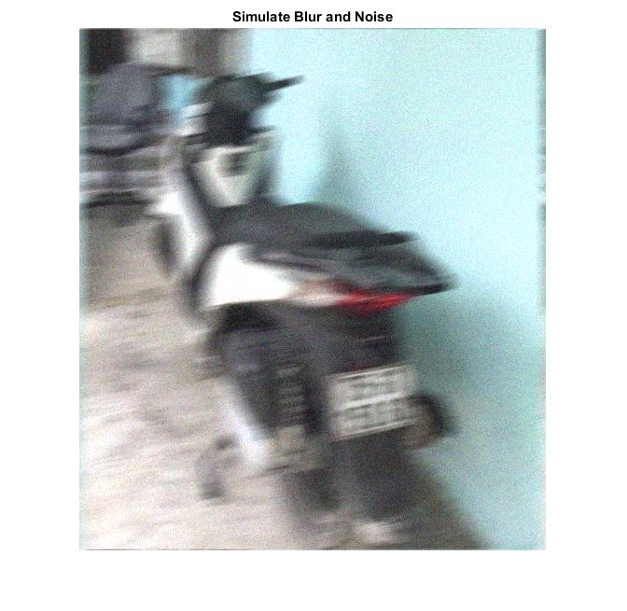
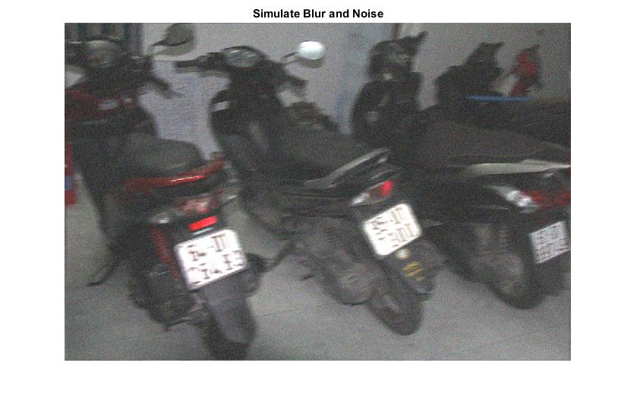
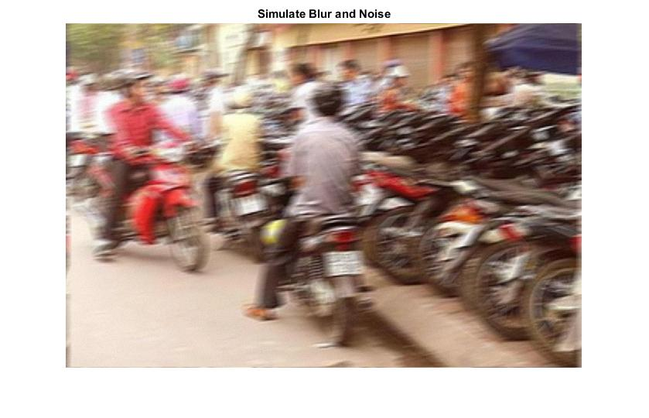
HW
Use deblur techniques to identify the tag number of these criminals

